Slide 1
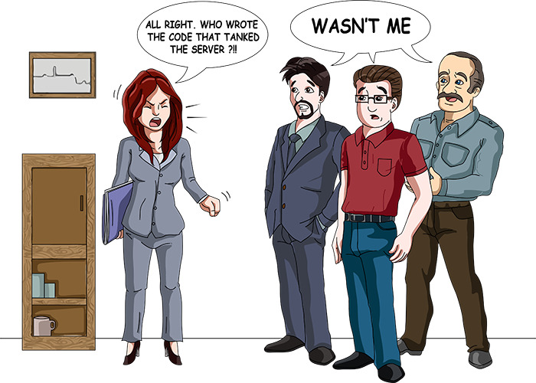
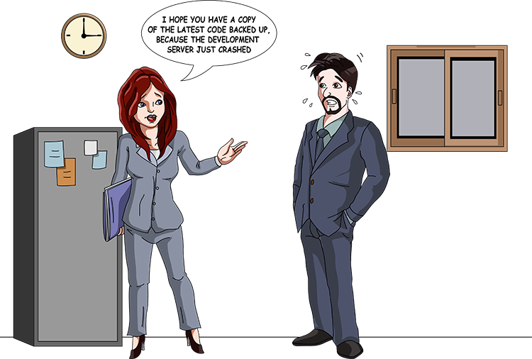
Have you been in any similar situation? How did you resolve the issue and what will you do in future?
Who is to blame?
Ever forgot to backup?

Slide 2

HAVE YOU CONSIDERED VERSION CONTROL/ VERSIONING?

Slide 3
VERSION CONTROL /VERSIONING
A software solution that can be used to manage changes to documents, codes, computer programs, large web sites, and other collections of information and promote collaboration. Examples are:
SVN
Mercurial
Git

Slide 4
Centralized VC vs. Distributed VC
Central Server
Remote Server
REMOTE REPOSITORY
REMOTE REPOSITORY
DEVELOPER 1
DEVELOPER 2
DEVELOPER 3
DEVELOPER 1
DEVELOPER 2
DEVELOPER 3
REPO COPY
REPO COPY
REPO COPY
Notes:
This is over simplifying the story, but the basics are that centralized version control system define a central authority.
I am not saying one system is better that the other, it is just that each model that its benefits.
In the distributed model by definition everything is expected to be off line. To have a system that expects everything to be offline, you have to build in several local capabilities that are not required in a centralized model.
Such as local branching. And to make branching fast and lightweight you better make merging great also.
I won’t go into the guts of git that enables some of this capability in this talk, but if you are interested I will highlight some resources at the end of the talk where you can go deeper.

Slide 5
Centralized Version Control
Traditional version control system
Server with database
Clients connect remotely to work
Examples
CVS
Subversion
Visual Source Safe
Challenges
Multi-developer conflicts
Client/server communication

Slide 6
Distributed Version Control
Authoritative server by convention only
Everyone can have a full tree copy of the remote repository
Get version control even when detached (offline)
Backups are trivial
Some distributed systems include
Git
Mercurial
BitKeeper
Darcs
Bazaar

Slide 7
Version control usage
What kinds of files can we use it with?
Source code
Documentation
Short stories
Binary files (music and pictures)
What should we use it for?
Text files
Projects that have lots of revisions (changes)
Collaborating

Slide 8







Git Version Control
A decentralized Version control system created by Linus Torvalds for work on the Linux kernel ~2005 at first.
Some of the companies that use git:
Hopefully VUT

Slide 9
Pros of Git Version Control
Decentralized in nature
The ability to see each change individually and merge desired changes easily
Agrees with the Agile process of team work (collaboration)
Larger community than other version controls
Faster operation speed than SVN (takes Git 1/3 of a second to copy and 13 seconds to do the same on SVN)
Full history tree available offline
Access is defined where necessary
Wide variety of plug-ins for IDEs

Slide 10
Cons of Git
Definite learning curve, especially for those used to centralized systems
Slow on top of NFS
Promote laziness

Slide 11
Individual vs Team Usage Comparison
One person project
Local repo is enough
No need to bother with remote
Small team project
SSH write access for a few core developers
GIT public read access

Slide 12
Branching and Merging
Why this is cool?
Non-linear development process
Clone the code that is in “production repo”
Create a branch for issue #53 (iss53)
Work for some minutes
Someone asks for a hotfix for issue #102
Checkout ‘production’
create a branch (iss102)
fix the issue and comment
checkout ‘production’, merge ‘iss102’
push ‘production’
checkout ‘iss53’ and keep working

Slide 13
Summary
Discussion – how do you perceive the use of version control and would you use it?
Lets Discuss it

Slide 14
Questions?

